Slide 1
HACKATHON
GROUP-III
Nayan Madhukar Chaudhari - 888048
Sayali Sudhir Kabade – 888074
Pooja Rajendra Lawand – 888104
Purva Deepak Madgaonkar – 888066
Sadiya Salim Shaikh - 888150

Slide 2
Project Description
For Bangalore city, identify Hospitals that is Open 24/7, has Parking facility with rating more than 3.5. Display the hospital names.
In Diagnostics page, pick all the top cities name & store in a List; Display the same.
Go to Corporate Wellness, fill invalid details, schedule & capture the warning message from the alert (Suggested Site : practo.com however you are free to choose any other legitimate site).
Site : https://www.practo.com

Slide 3
TOOLS
Eclipse IDE
TestNG
Maven
Jenkins
GitHub

Slide 4
FIRST DESCRIPTION
Display the hospital names for “Bangalore” city, identify Hospitals that are “Open 24/7”, has “Parking” facility with “rating more than 3.5”.

Slide 5
Practo.com website should be open.
Select “Bangalore” from city search field.
Type “Hospital” in next search field.
The hospitals list will get displayed in next page. Apply filters on it.
Click the checkbox which is in front of “Accredited” for Rating filter.
Click the checkbox which is in front of “Open 24x7”.
Click on Apply filter dropdown.
Click the checkbox which is in front of “Has parking”.
Click the checkbox which is in front of “Cafeteria”.
List of Hospitals from Bangalore city which are open 24x7, have parking facility, cafeteria and rating more the 3.5 should be displayed.

Slide 6
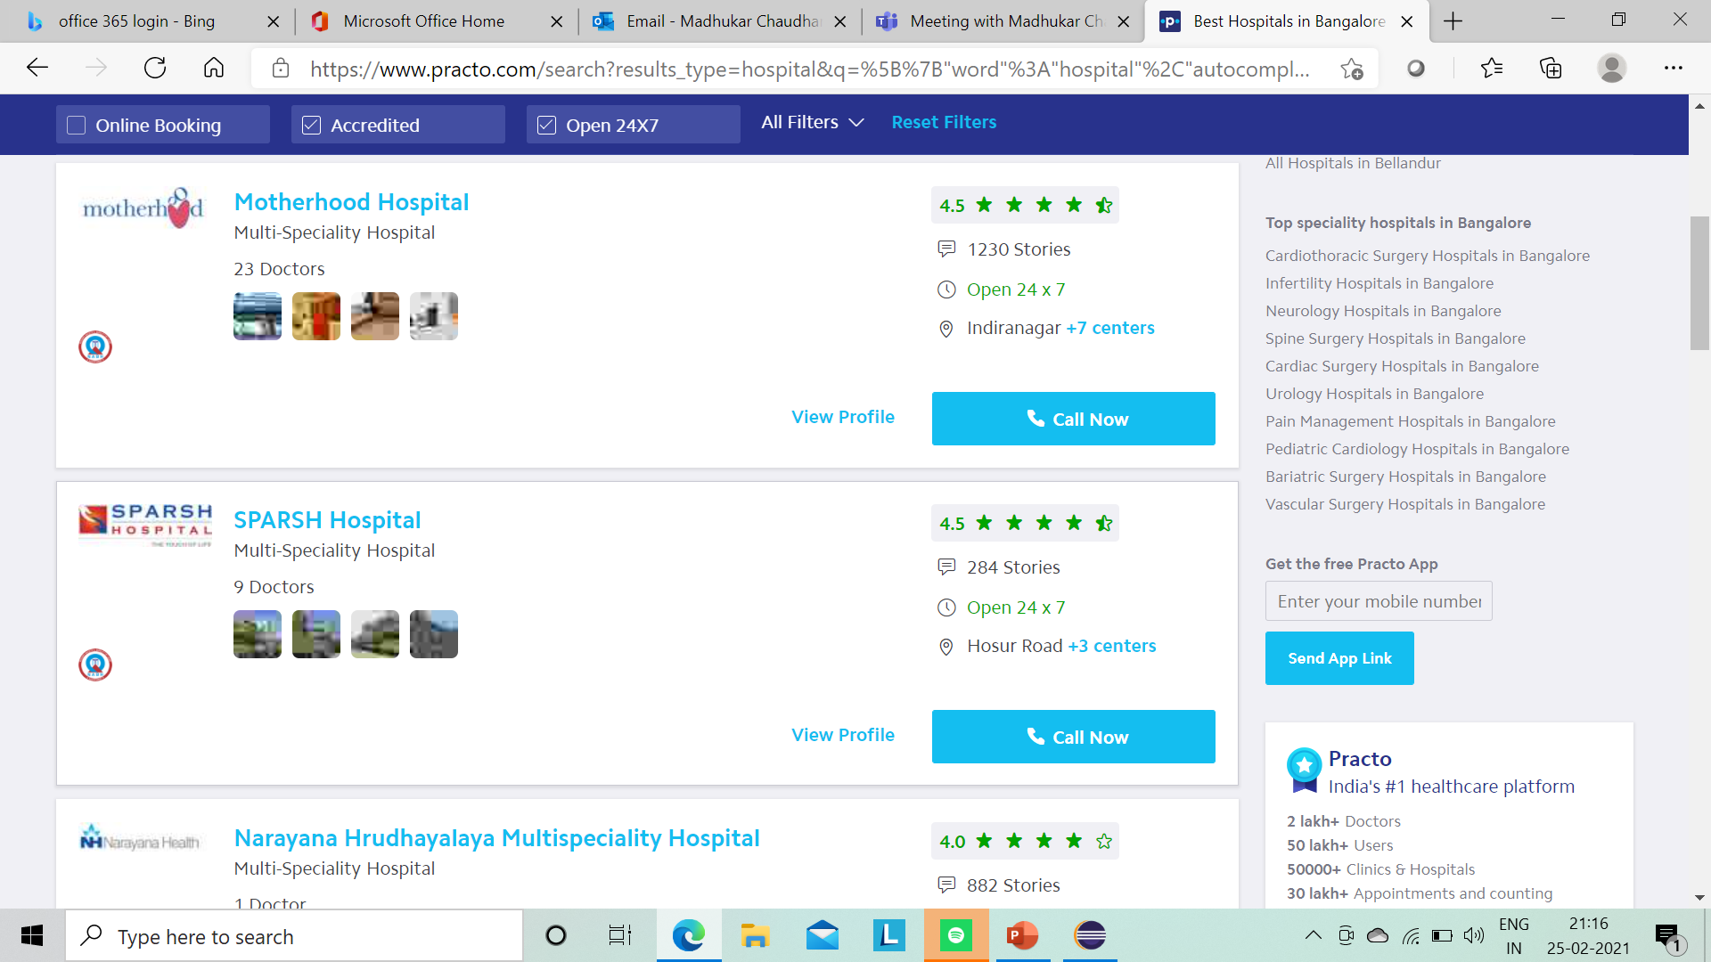
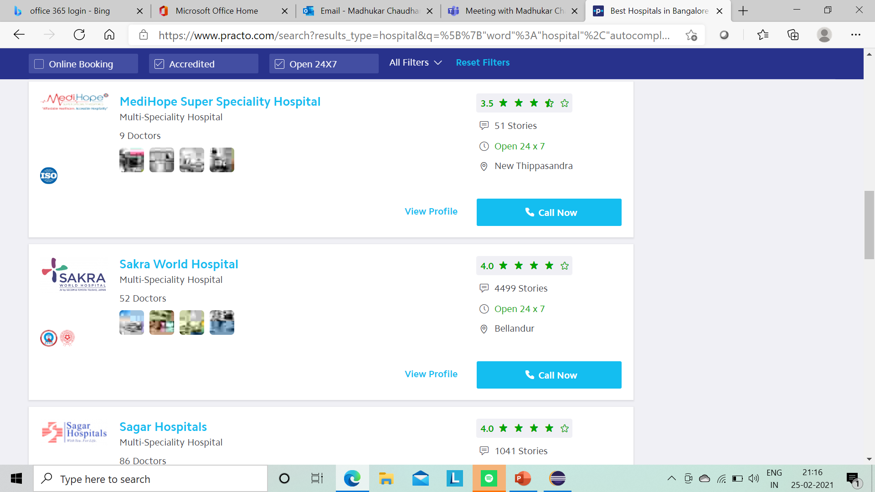

Slide 7
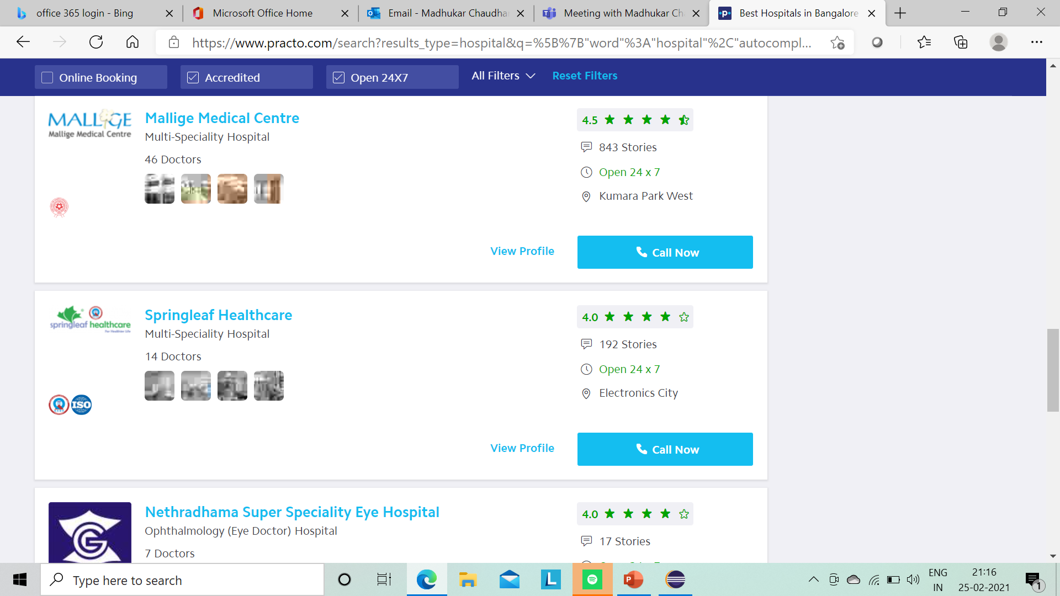
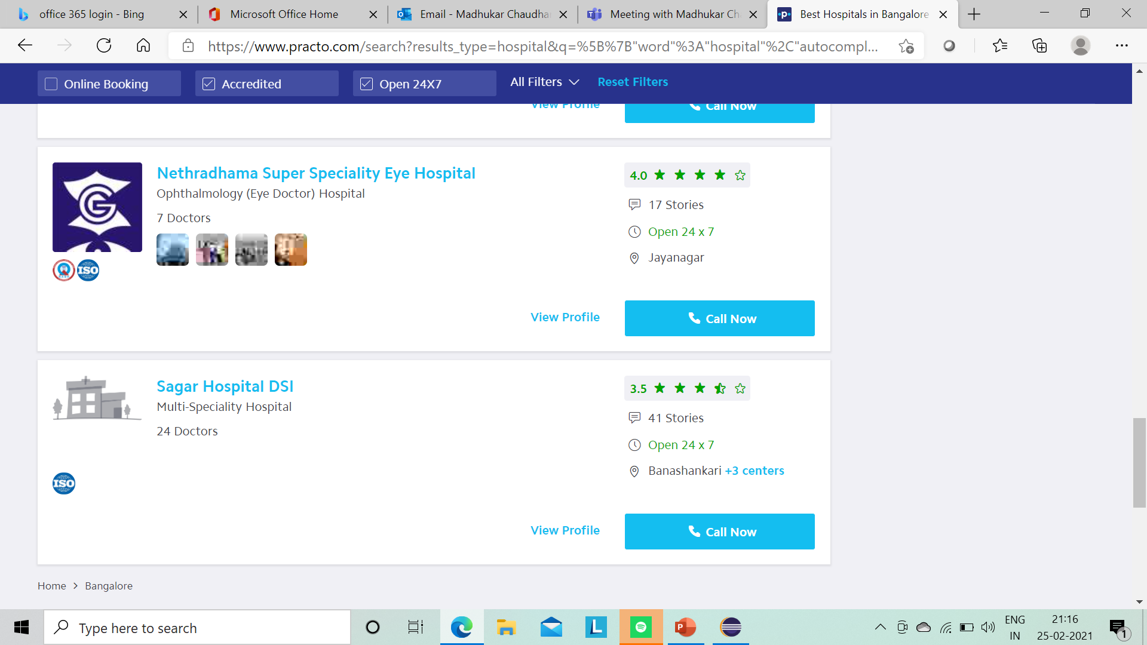

Slide 8
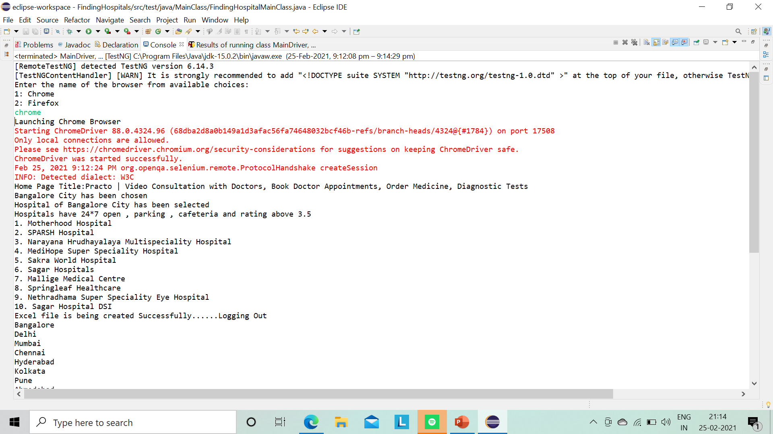
Hospital names Displayed on the console

Slide 9
SECOND DESCRIPTION
In Diagnostics page, pick all the top cities name & store it in a List. Display the top cities name.

Slide 10
Click on the Diagnostics
Click on the city text box
Top cities names should get displayed

Slide 11
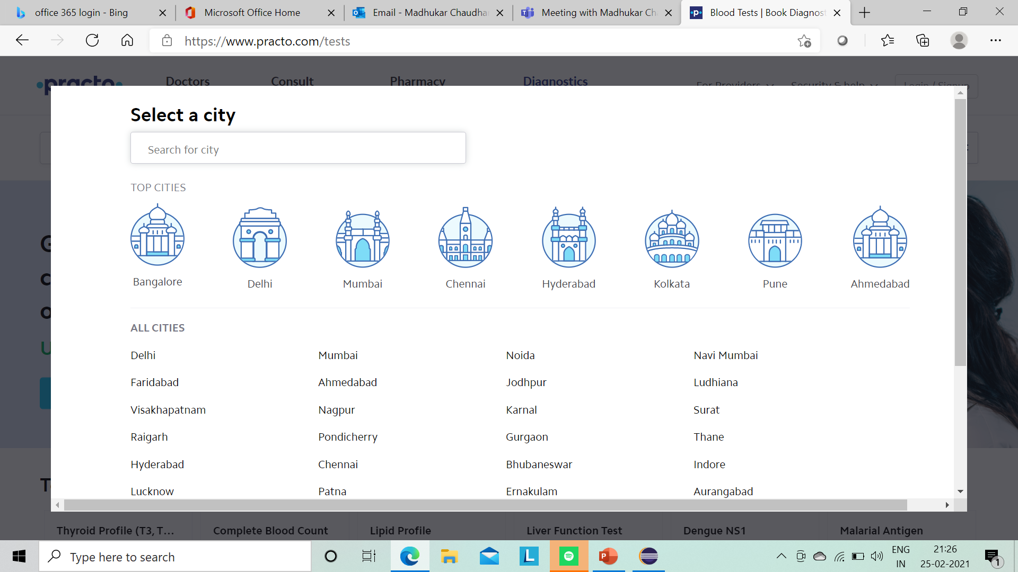
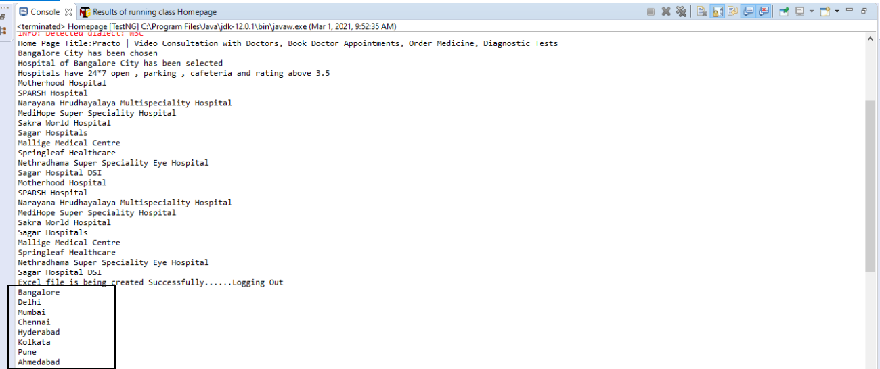

Slide 12
THIRD DESCRIPTION
Go to Corporate Wellness, fill invalid details, schedule & capture the warning message from the alert

Slide 13
Click on the Corporate Wellness link.
Enter name, organization name, contact number and invalid email address.
Click on schedule demo button.
“Please enter valid email address” error message should be displayed.

Slide 14
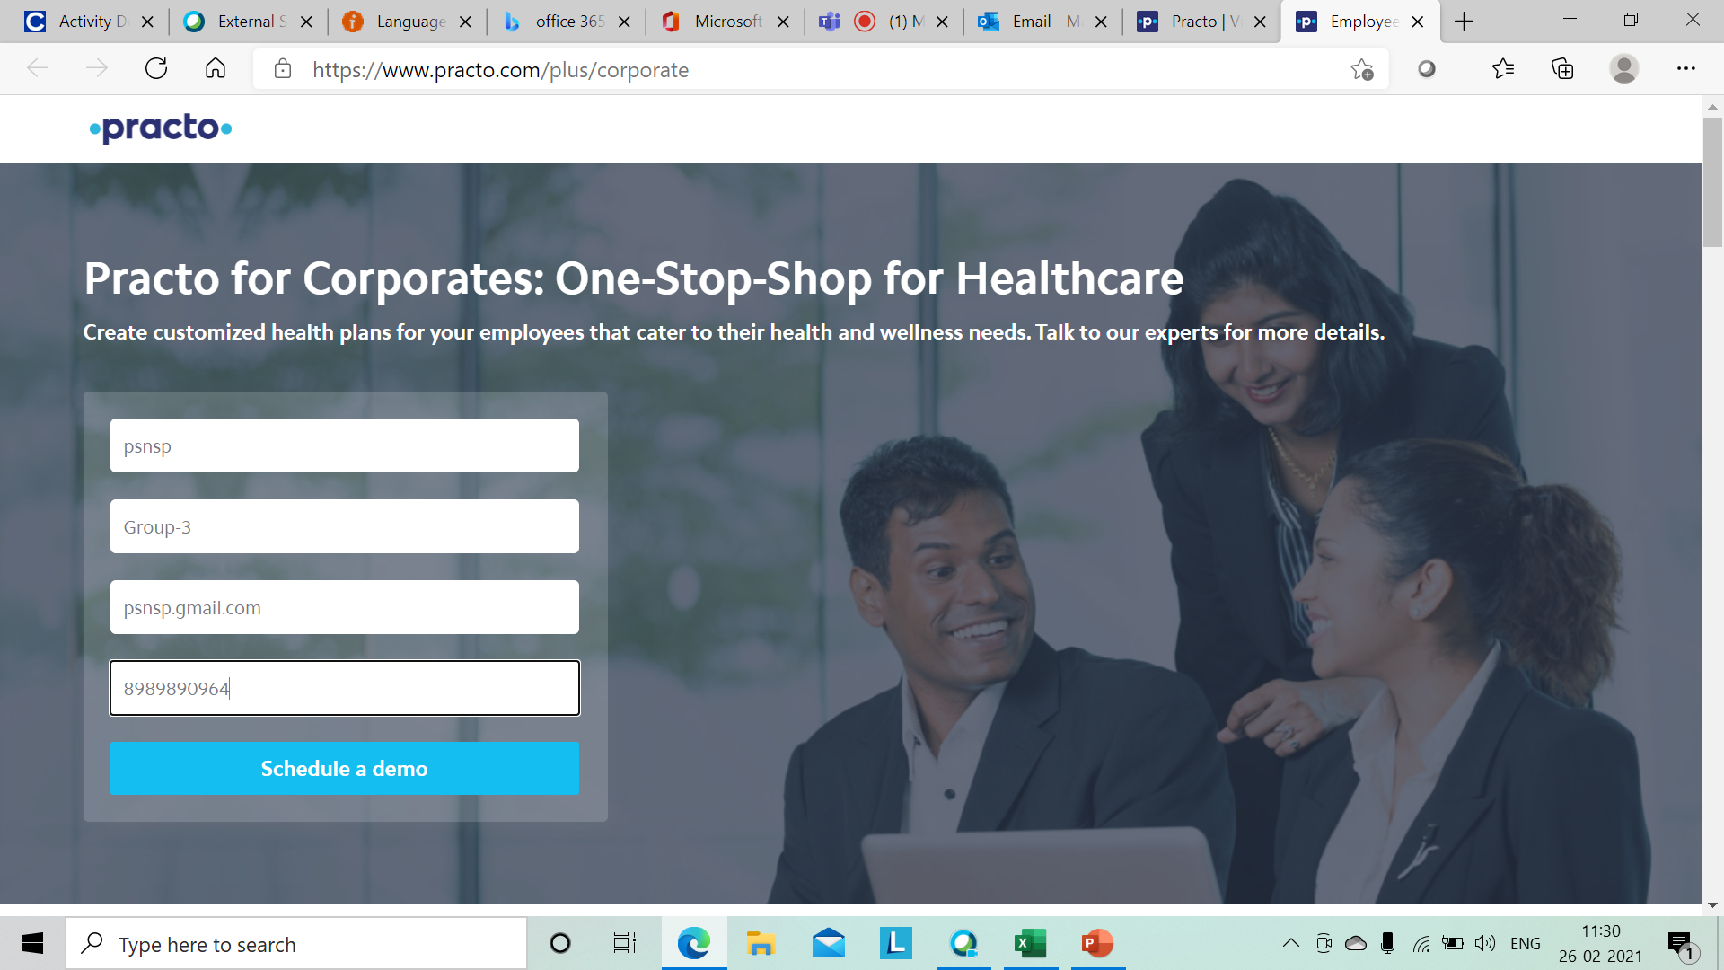
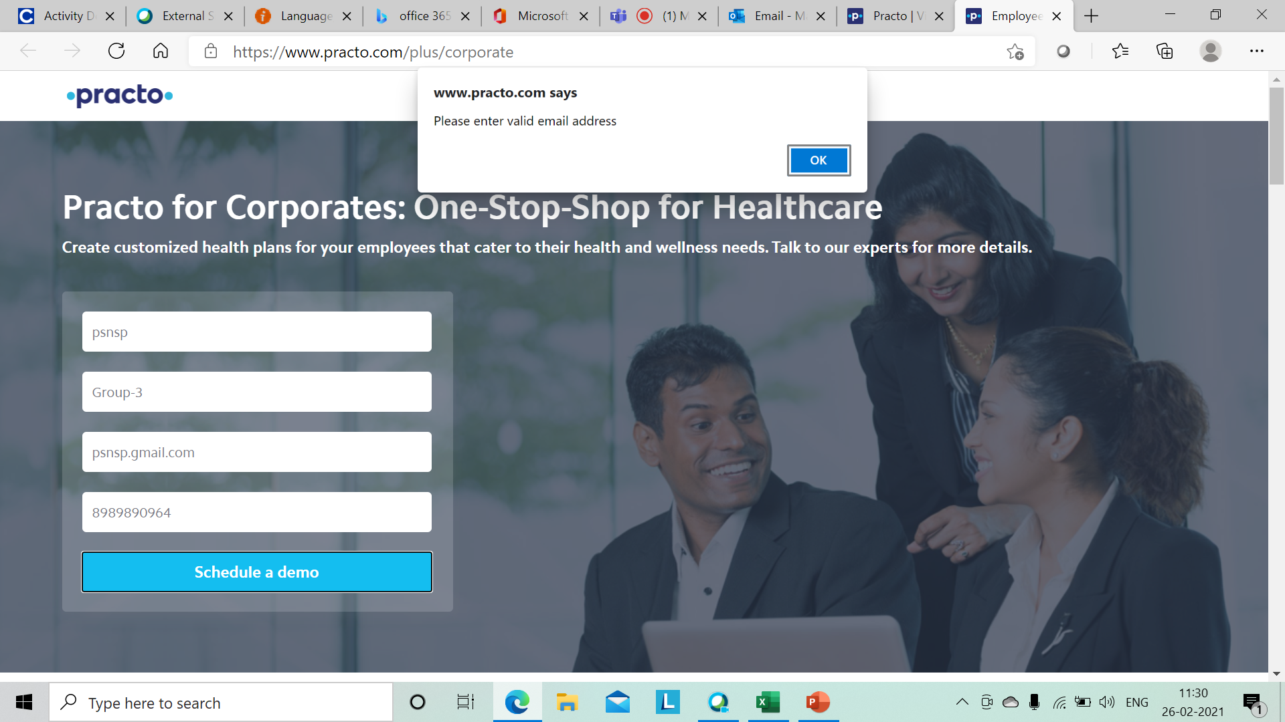
Entering invalid email to capture the error message.
Error message is Displyed.

Slide 15
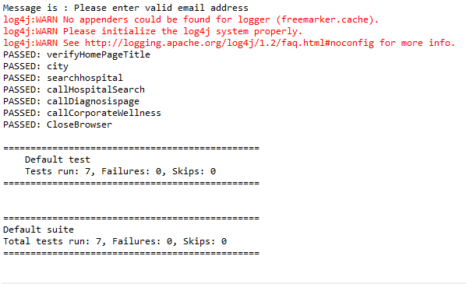
Console Output

Slide 16
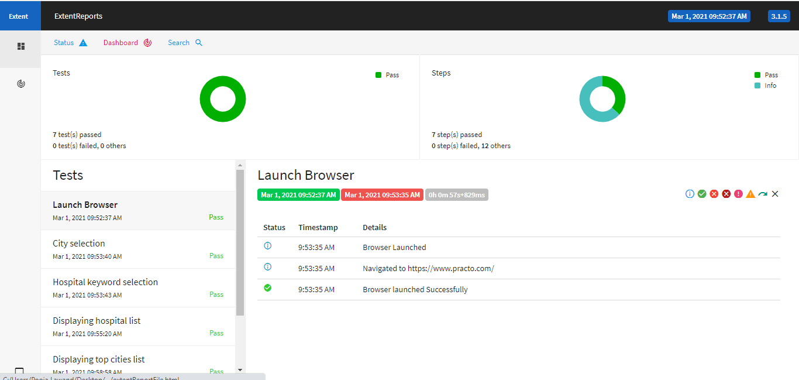
Extent Report

Slide 17
Thank You

